Slide 1

PCWG-Share-X Update
20th May 2016
Peter Stuart

Slide 2
PCWG-Share-01: Data Flow
Hypothesis/Trial Methodology
Analysis Definition Y
Analysis Definition Y
Analysis Definition Y
Analysis Definition Y
Proprietary Dataset A
Proprietary Dataset B
Proprietary Dataset C
Proprietary Dataset D
Organization A
Organization B
Organization C
Organization D
Hypothesis Performance Metrics
Aggregator
(Academic Institution )
Combination Analysis
How well did the trial method perform?
Aggregated Hypothesis Performance Metrics

Slide 3
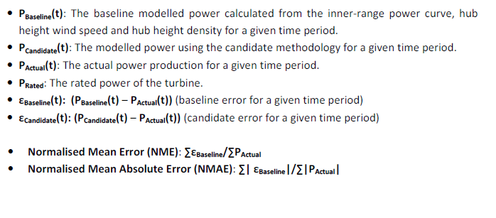
PCWG-Share-01: Error Metric Definitions
See PCWG-Share-01 Definition Document for Further Details

Slide 4
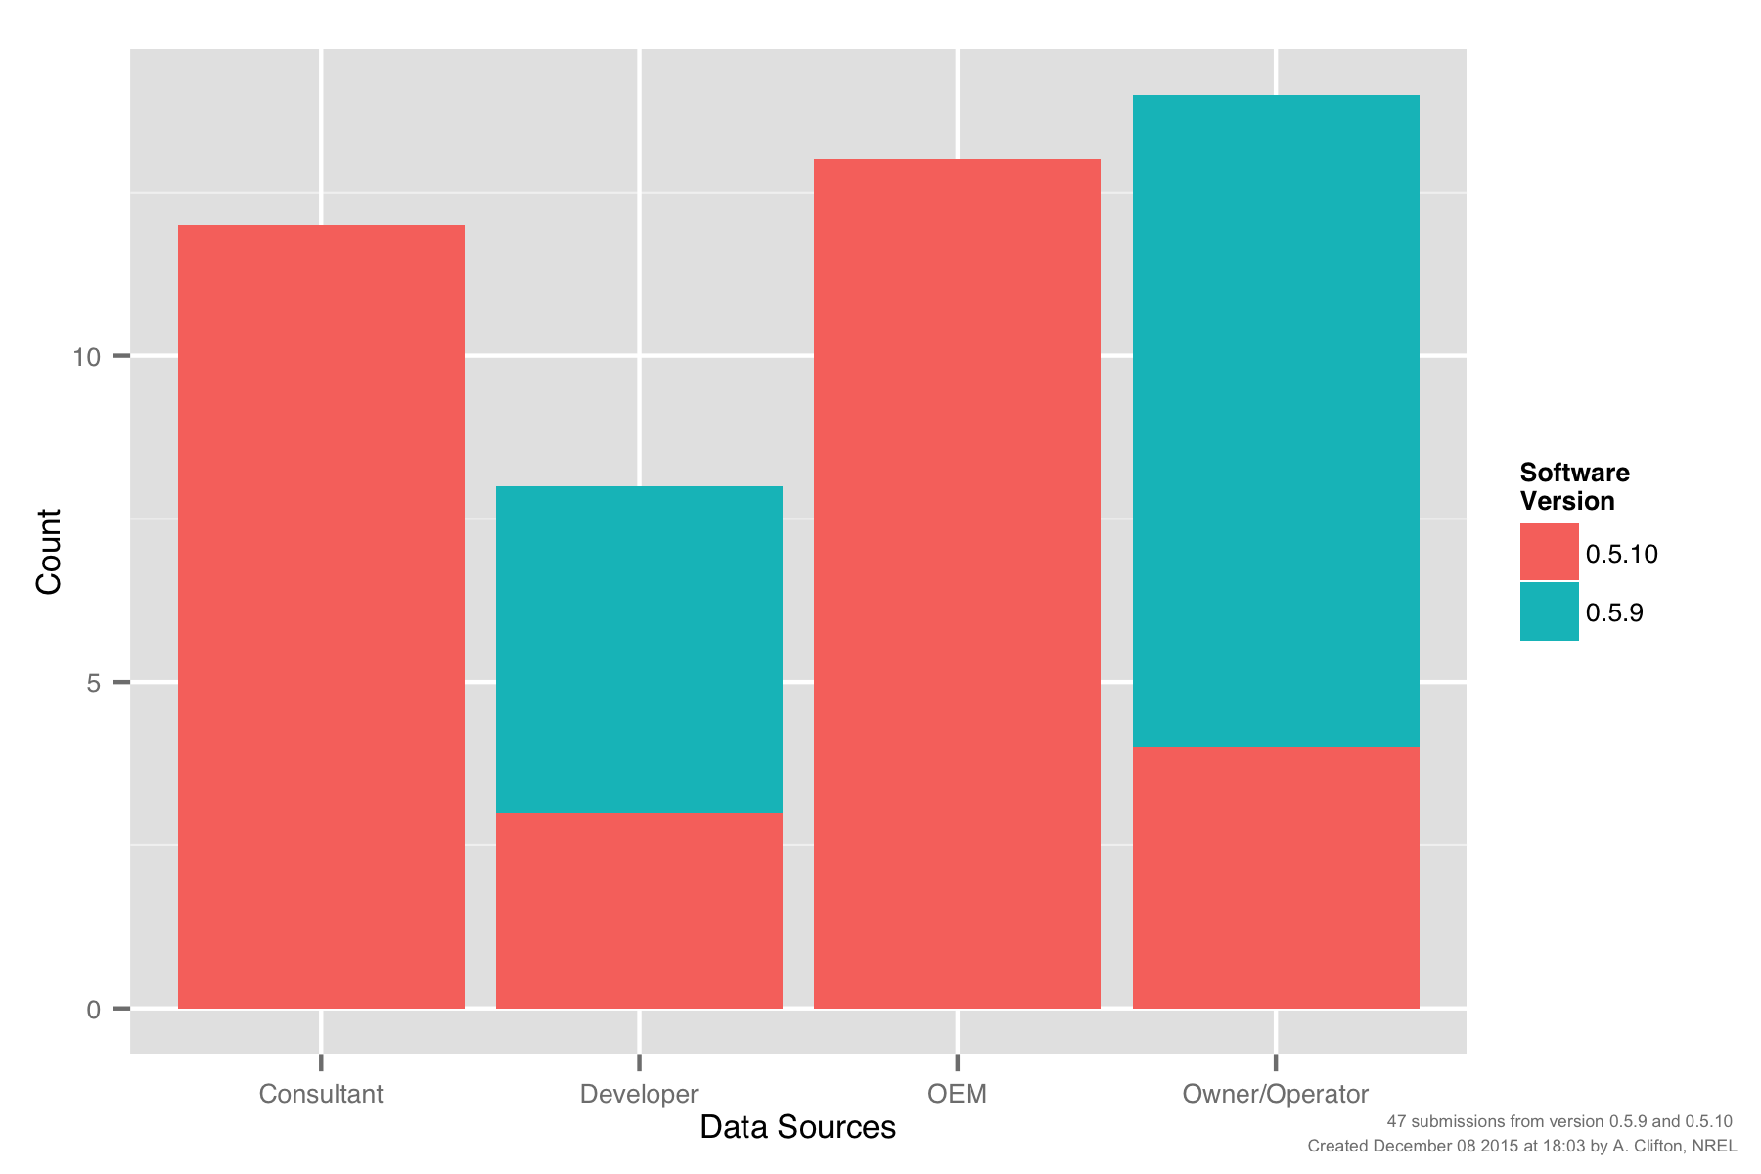
PCWG-Share-01: Submissions by Participant Type

Slide 5
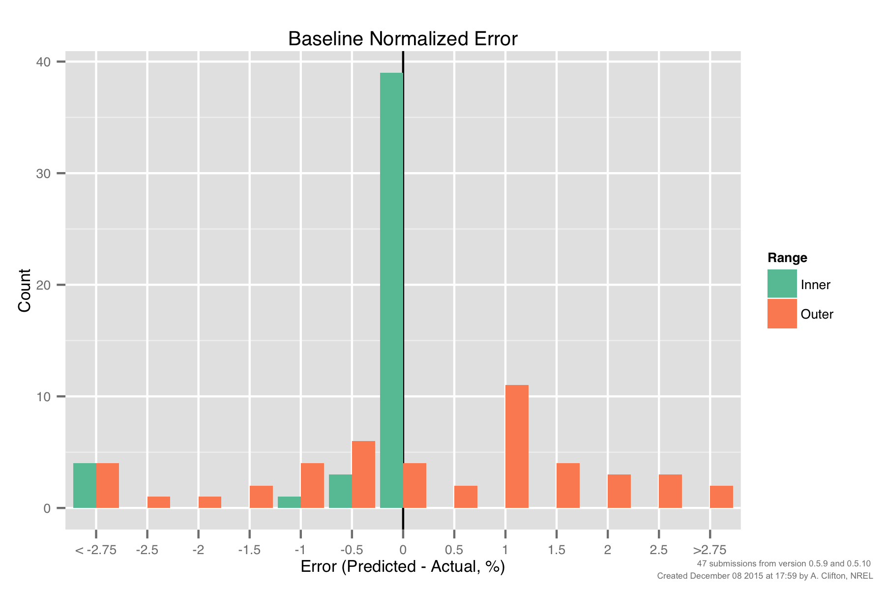
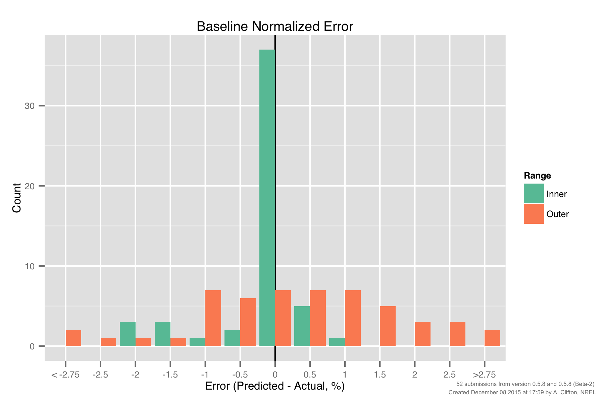
PCWG-Share-01: Baseline Error, Inner vs Outer Range
Version 0.5.9/10
Still unexpectedly large errors for baseline inner range
(further investigation required)
Smaller inner baseline errors still warrant further investigation
‘Uncertainty’ associated with
‘Outer Range’ effects.
Std Dev ≈ 2%

Slide 6
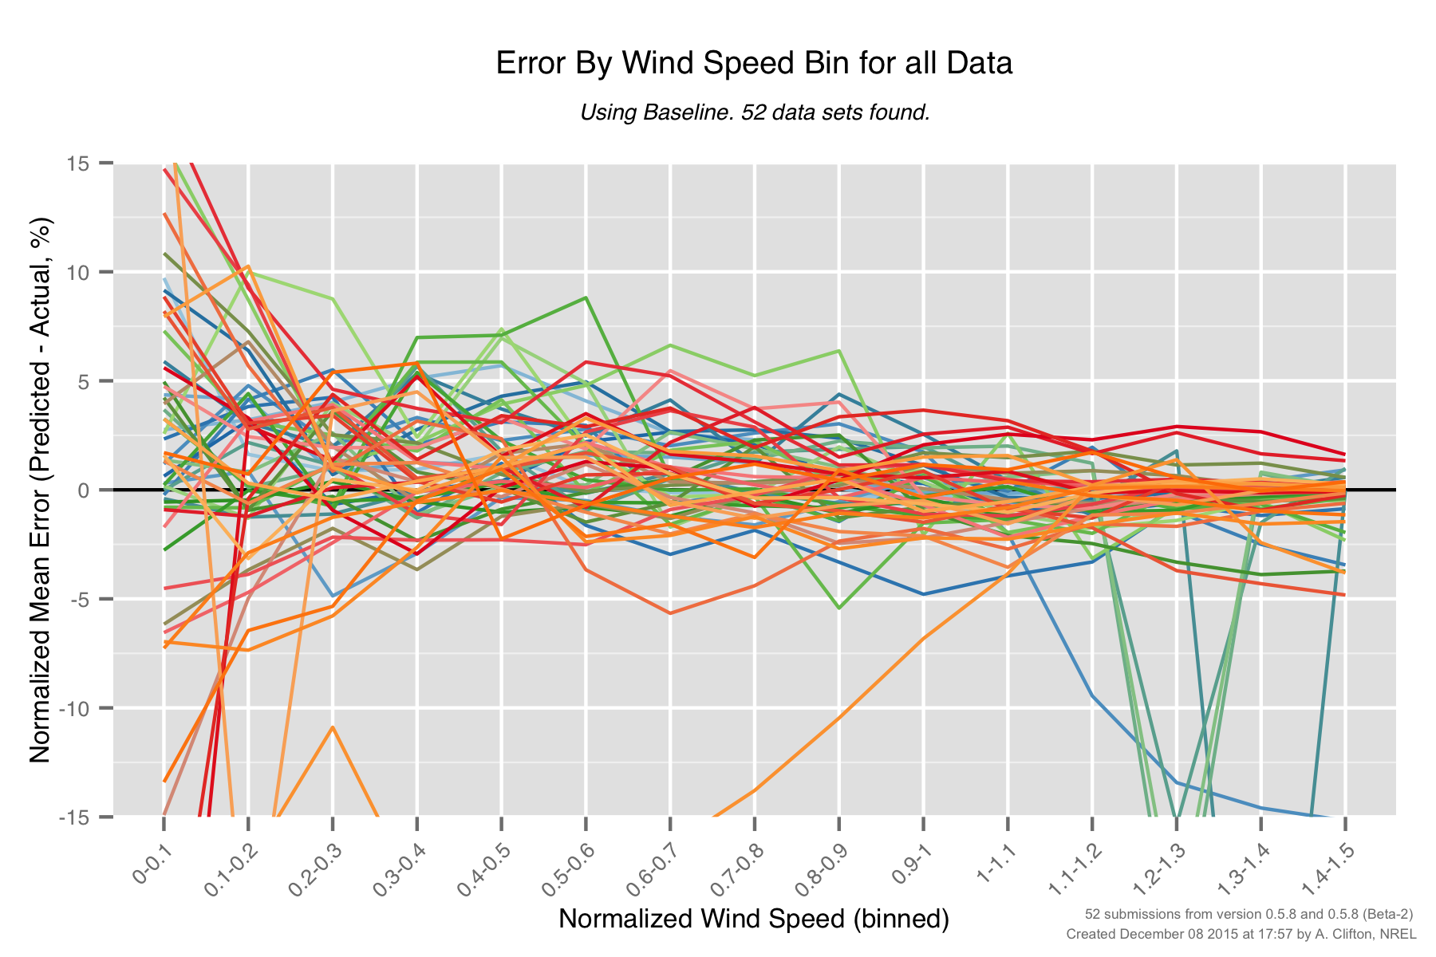
PCWG-Share-01: Baseline Errors by Wind Speed (0.5.8)
Large errors above rated for certain datasets.

Slide 7
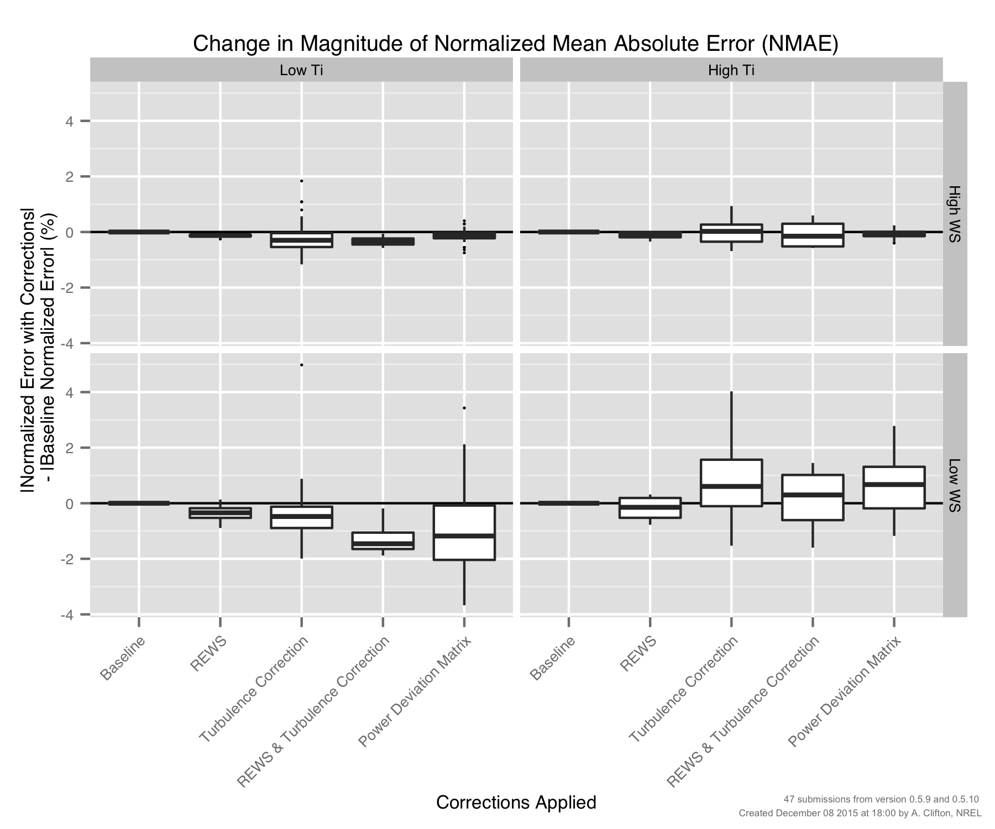
PCWG-Share-01: Errors by Method (‘Four Cell Matrix’)

Slide 8
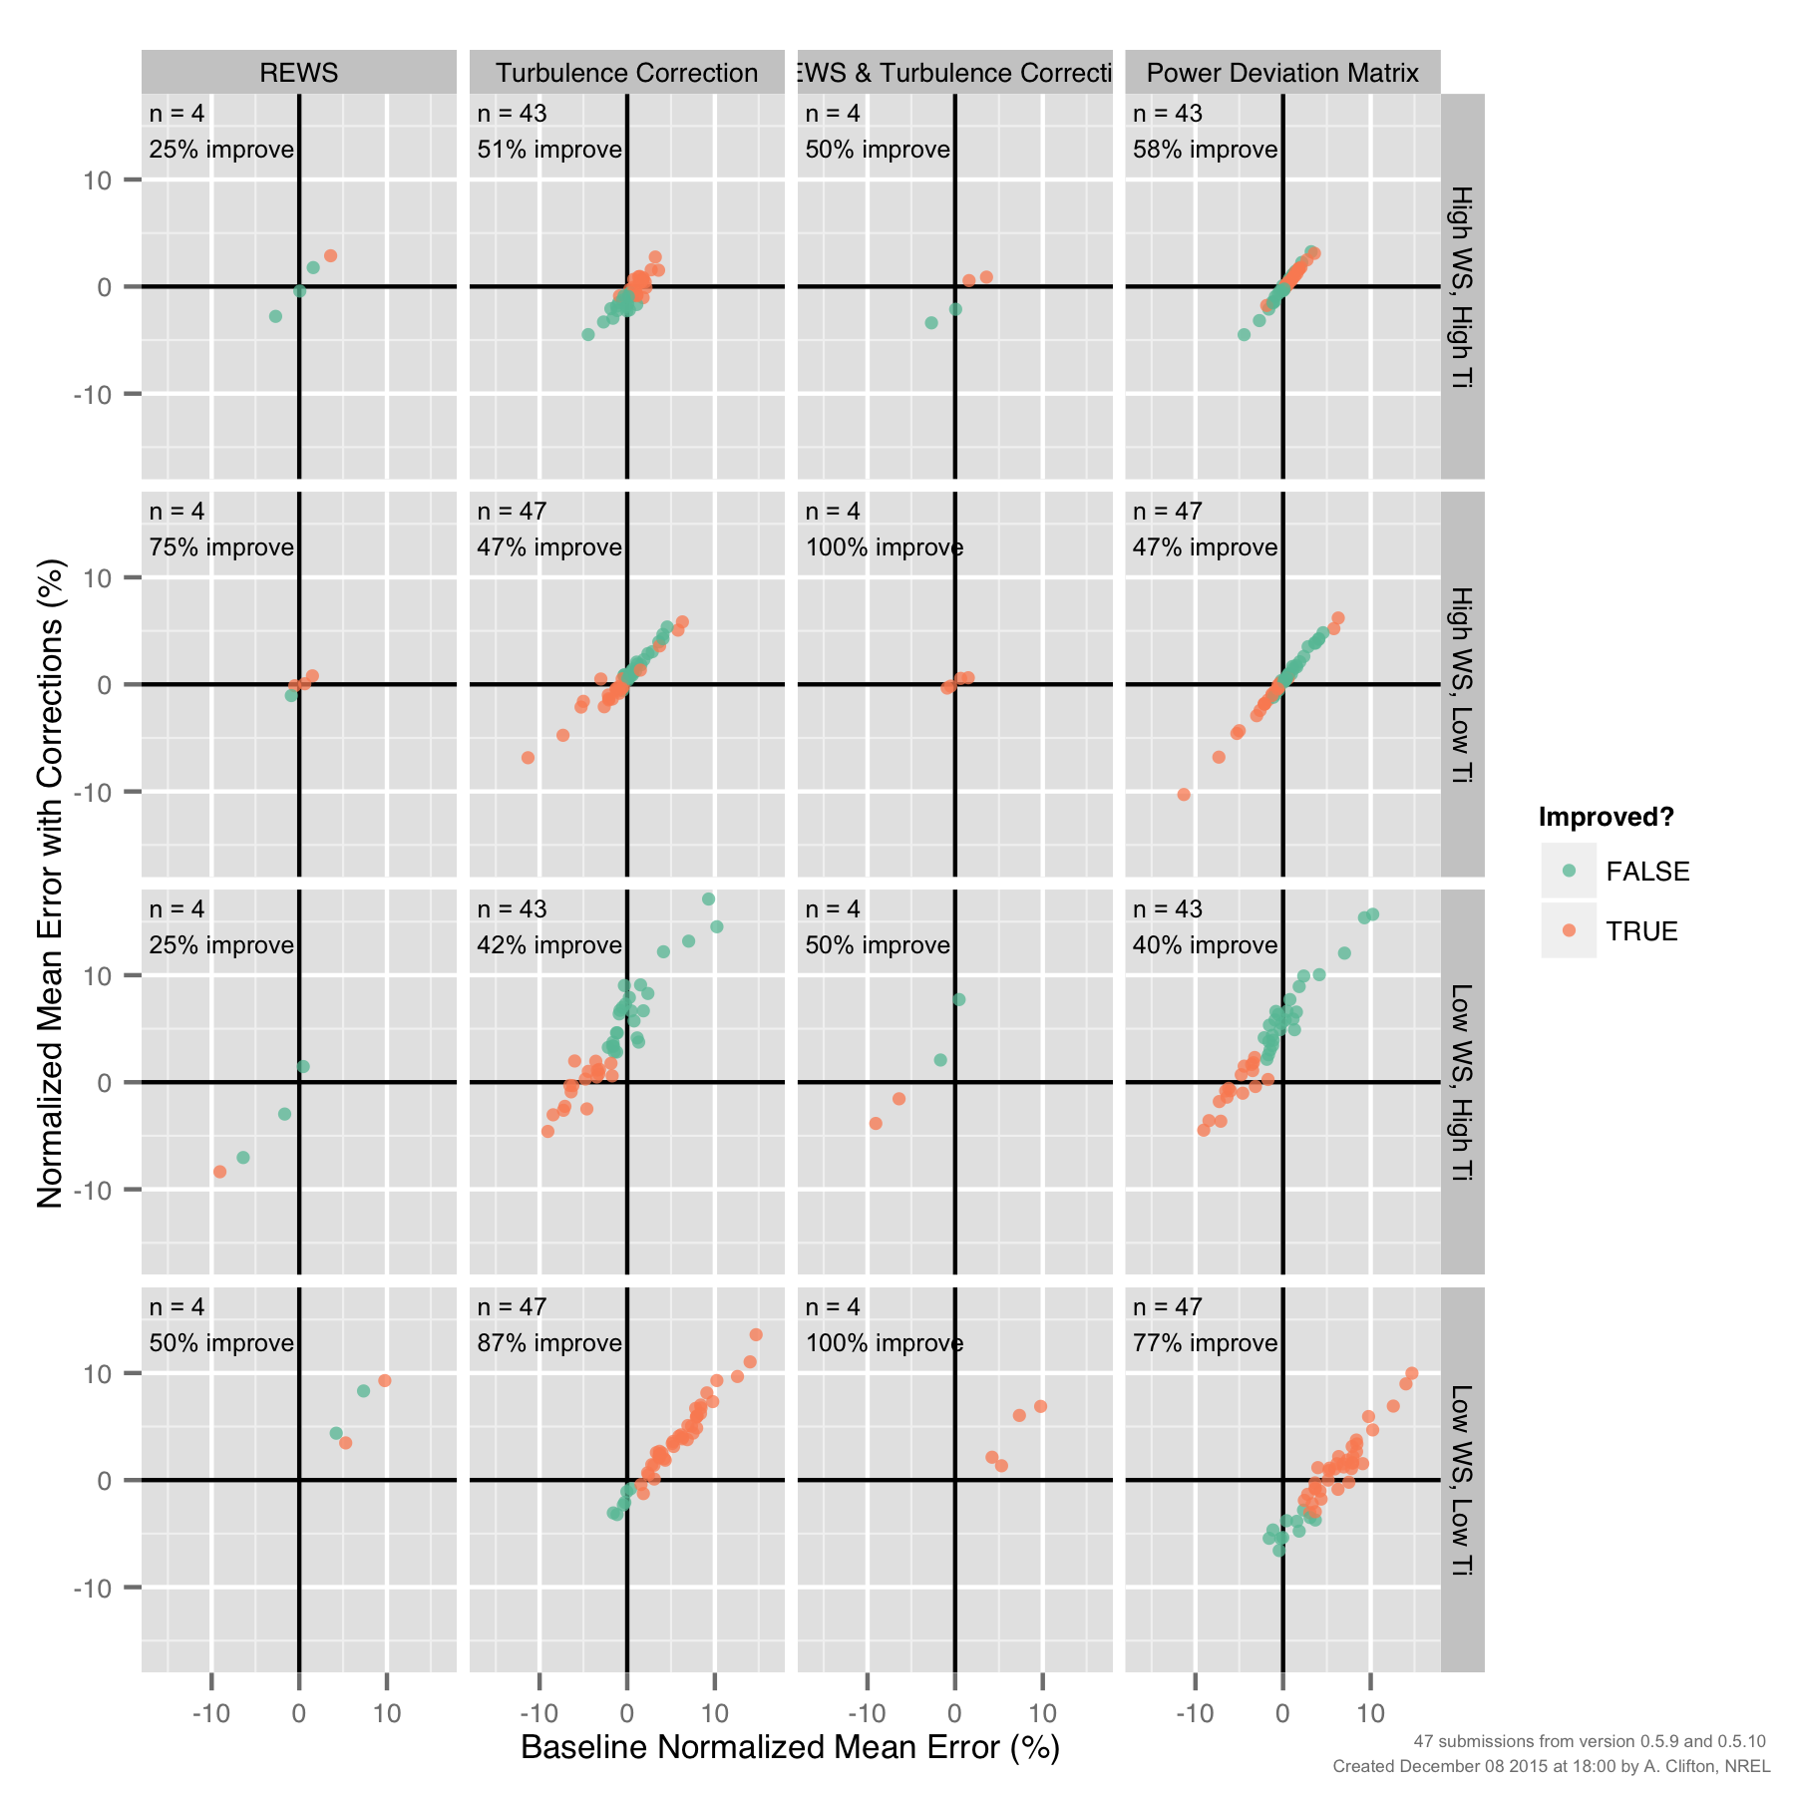
PCWG-Share-01: Improvements by Method (‘Four Cell Matrix’)

Slide 9
Erroneous Outlier Issue

Slide 10
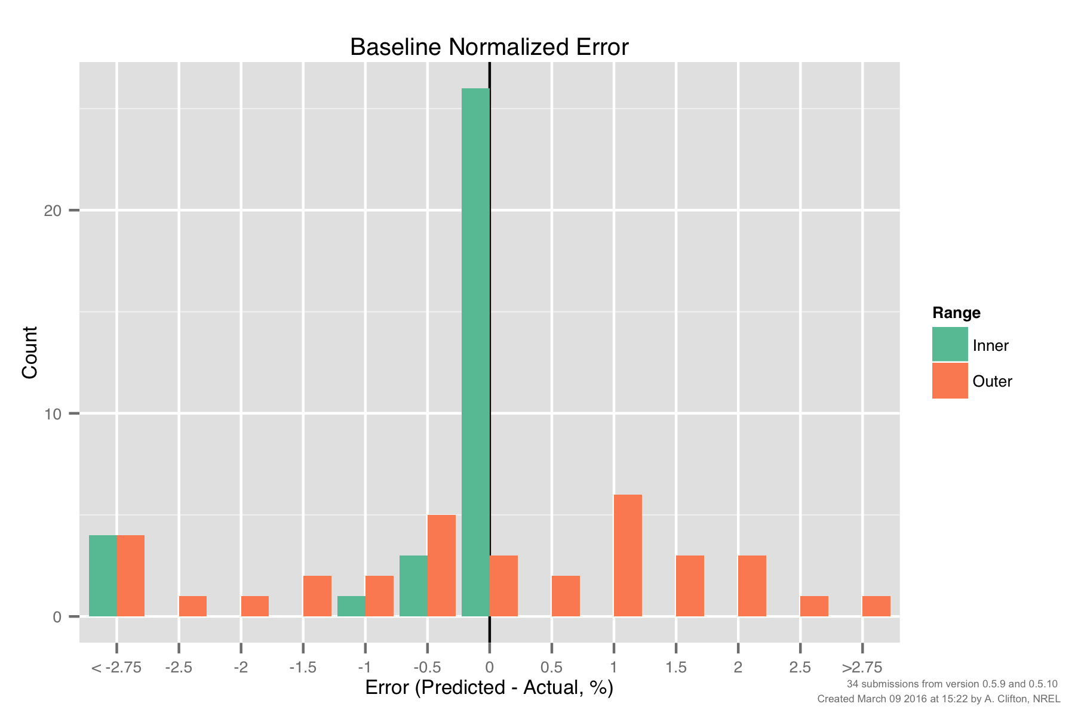
PCWG-Share-01: Baseline Histogram for ‘Follow Up’ Datasets
PCWG participants were asked for permissions to allow the data aggregator to investigate their submissions for sources of error.
Owners of 34 datasets responded positivity. A baseline NME histogram for these participants is shown below.

Slide 11
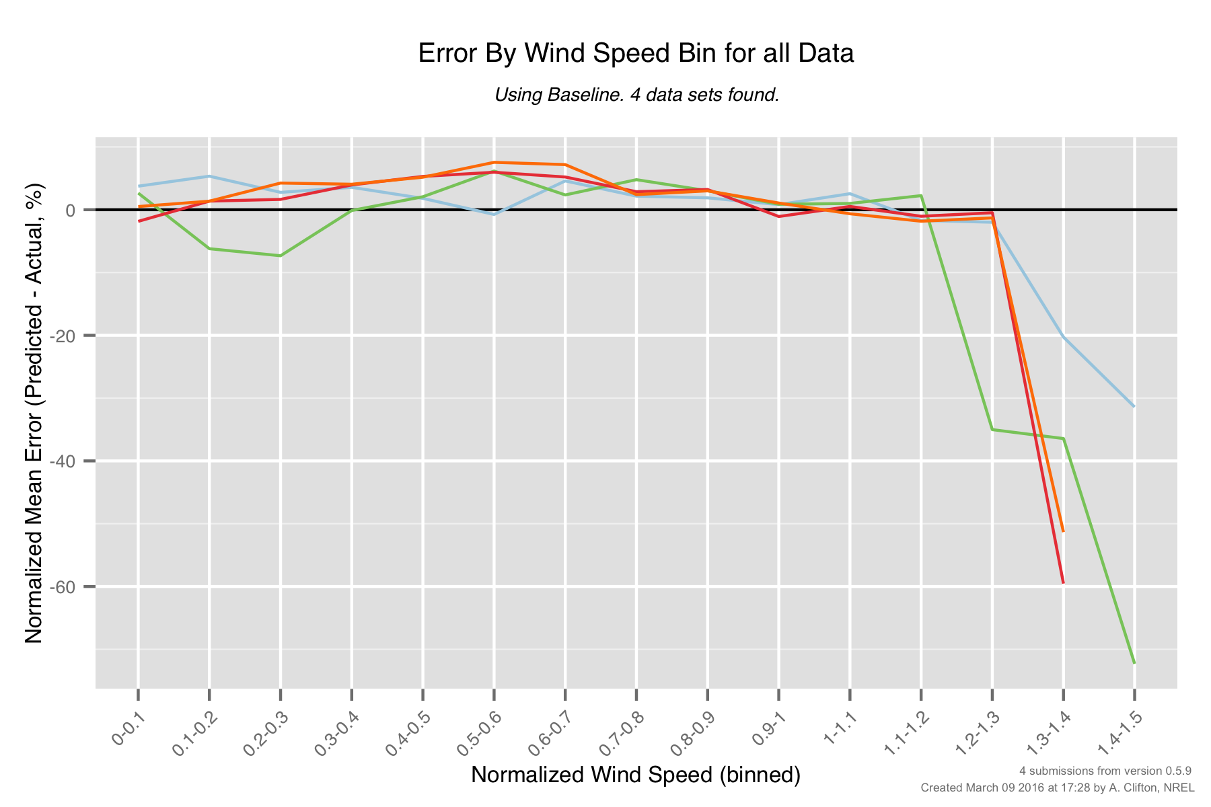
PCWG-Share-01: Baseline Errors by Wind Speed (Outliers Only)
The 4 large negative NME outliers all have a distinct ‘by wind speed error signature’.
Further investigation is required to ascertain what is going on with these datasets.
Large errors at high wind speeds

Slide 12
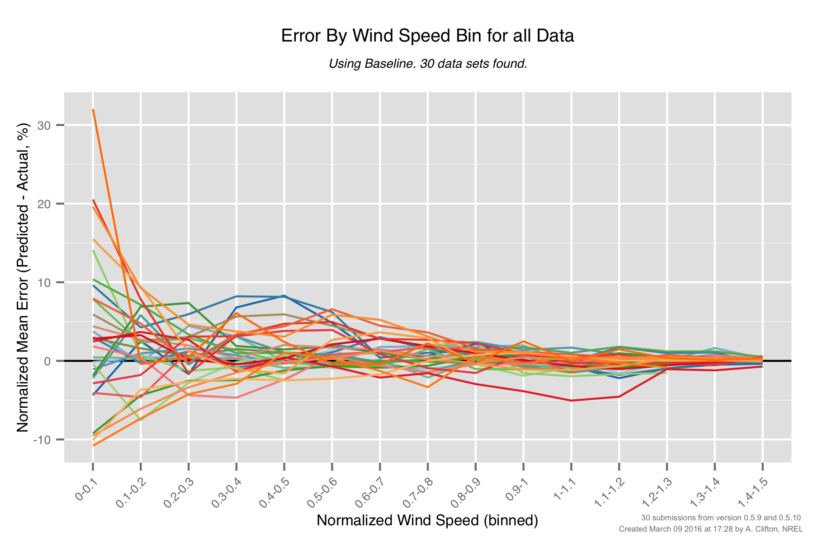
PCWG-Share-01: Baseline Errors by Wind Speed (Non-outliers)
The ‘by wind speed’ errors of the non-outliers look more reasonable, although some notable behaviour is observed (as highlighted).
Re-plot once interpolation issue is resolved.
Interpolation Issue
Notable behaviour for ‘blue’ dataset.
Notable behaviour for ‘red’ dataset.

Slide 13
POWER CURVE
INTERPOLATION ISSUE

Slide 14
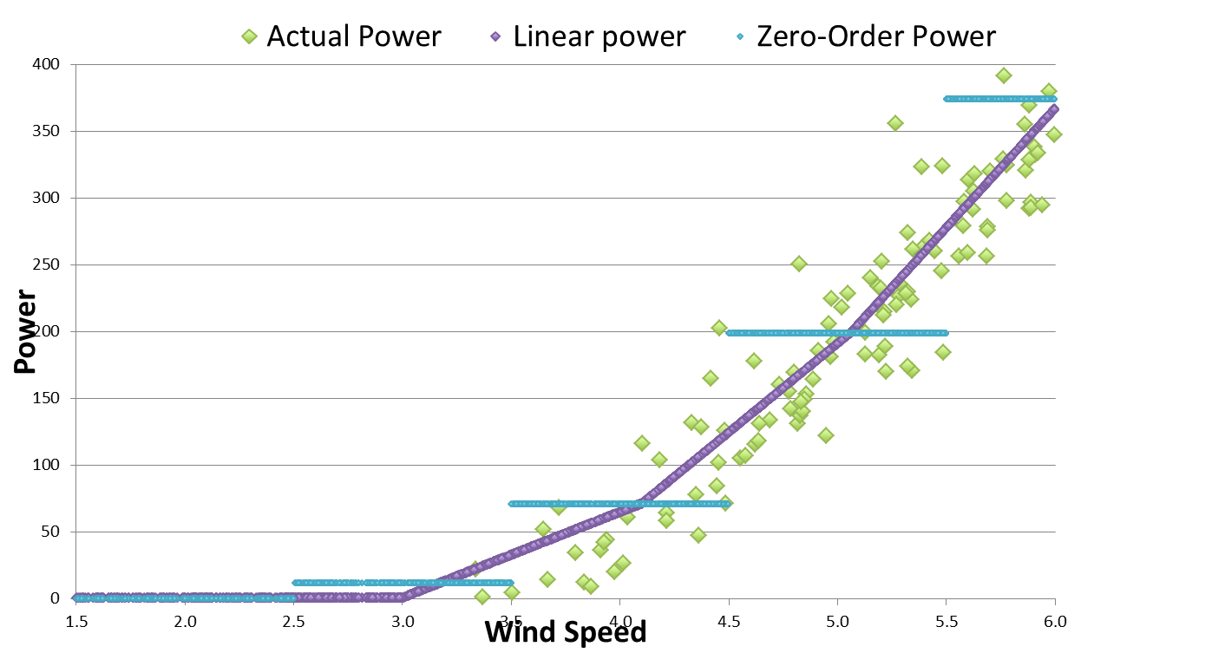
Linear Interpolation: v0.5.8 and earlier, improvement for individual data points but noticeable over prediction at low wind speed

Slide 15
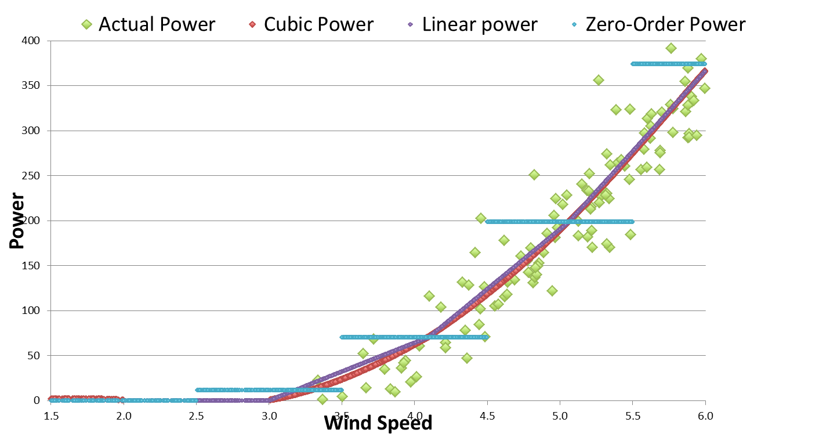
Cubic interpolation: introduced in v0.5.9 for PCWG-Share-01. Noticeably reduces error at low wind speed compared to linear.

Slide 16
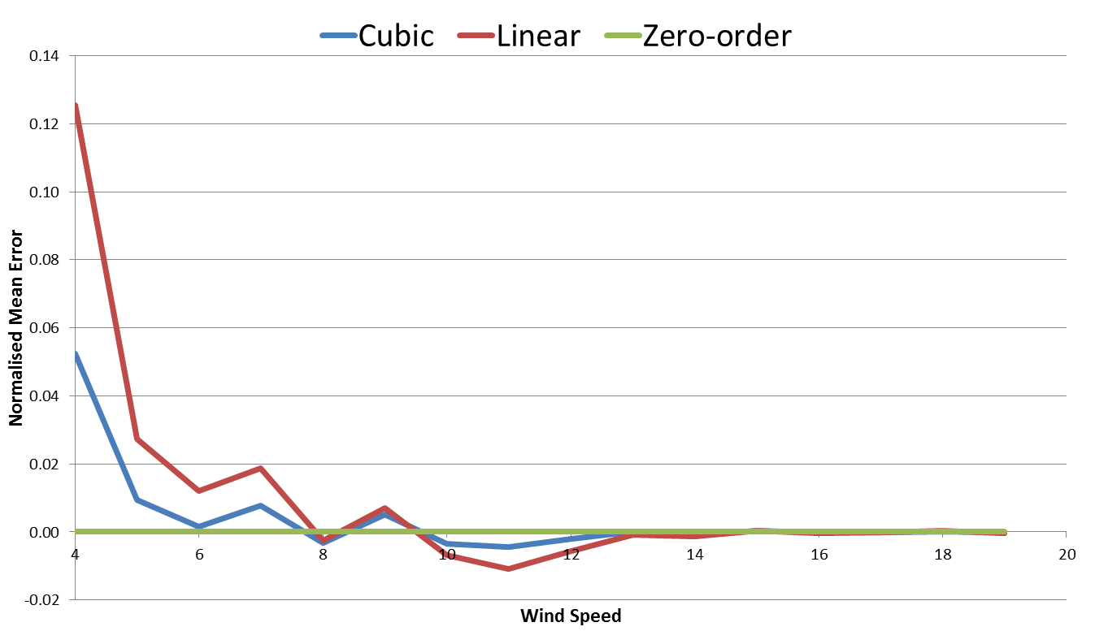
Normalised Mean Error (NME) by wind speed:
Cubic interpolation has similar but smaller errors than linear.
Zero-order has 0 error by definition
Cubic and linear interpolators over estimate data at the ankle
Cubic and linear interpolators under estimate data at the knee

Slide 17
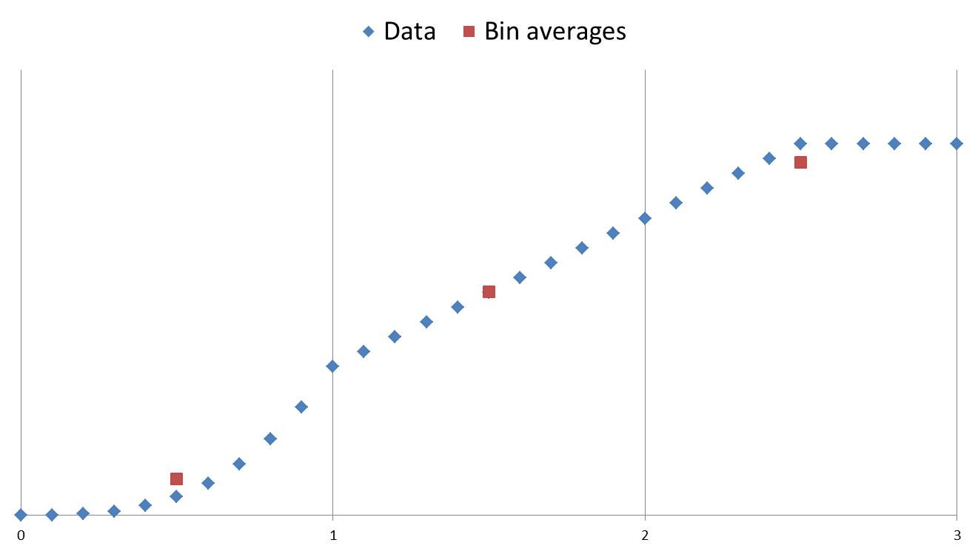
Residual Error
Main reason for residual error: Bin averages are used as interpolation points. Unfortunately the bin averages do not lie exactly on the curve when the underlying function is non-linear.
Cubic
(Convex)
Clipped
(Concave)
Linear
The bin average, (avg(x), avg(y)),
is below the curve
The bin average, (avg(x), avg(y)),
is above the curve
The bin average, (avg(x), avg(y)),
is on the curve

Slide 18
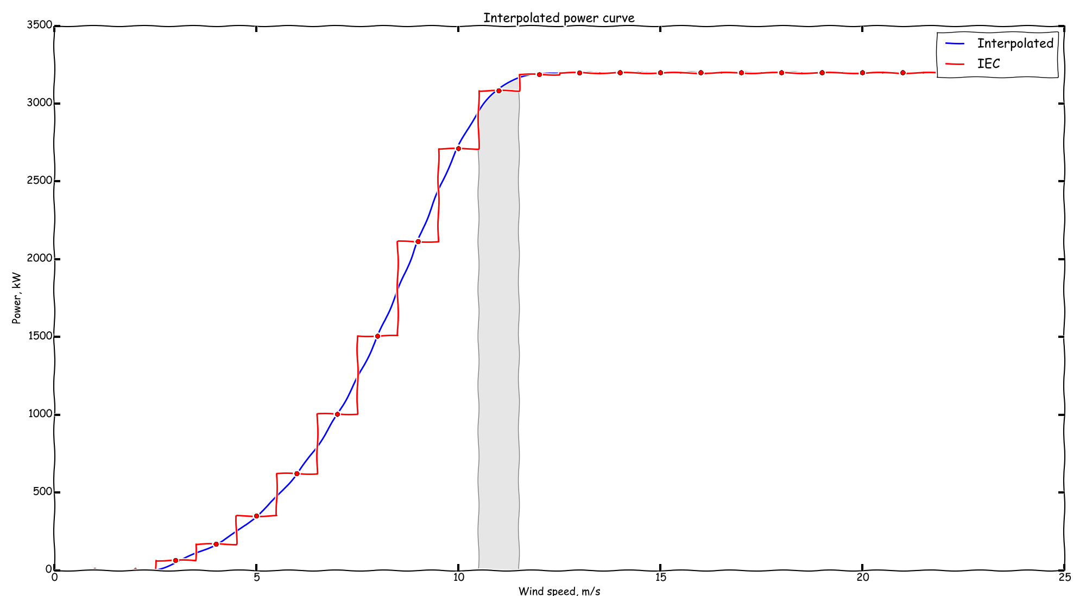

Slide 19
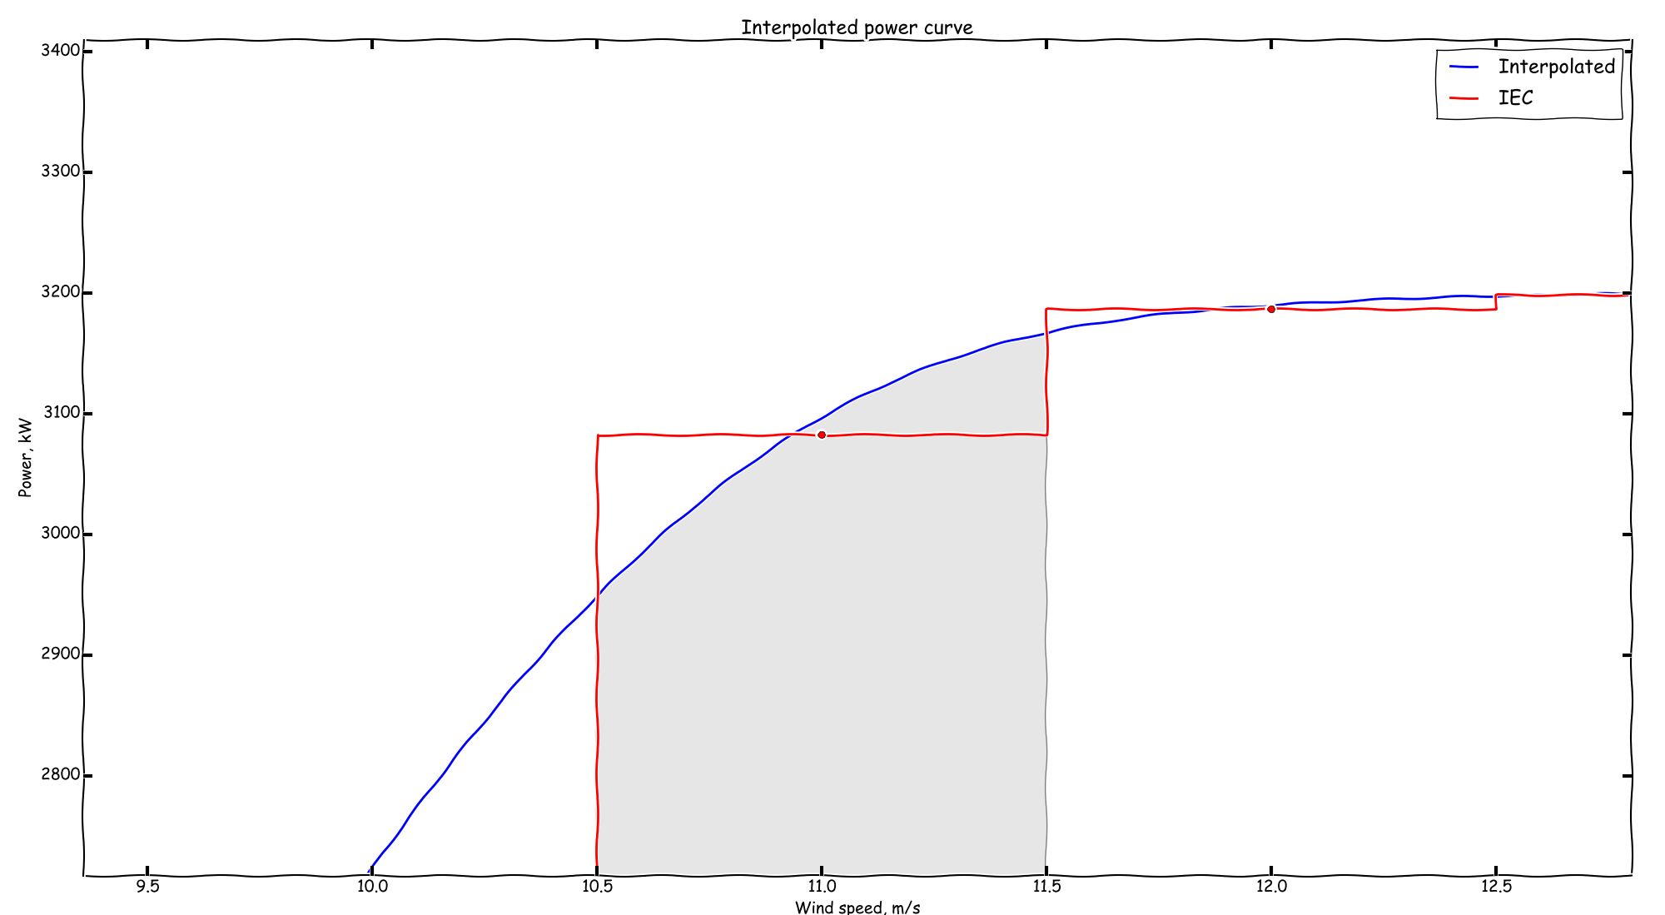

Slide 20
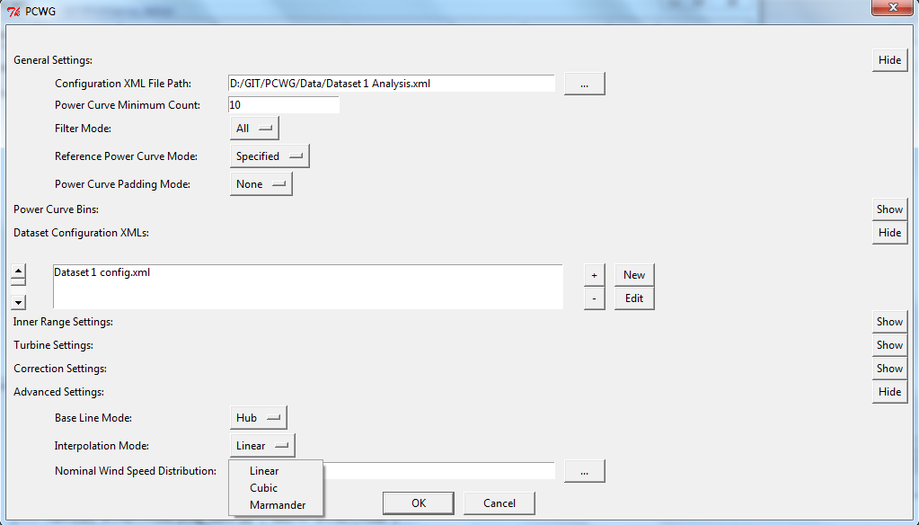
Interpolation Error – Follow Up
Proposed solution now implemented in PCWG tool (Marmander method). Next round of sharing initiative will utilise this method.

Slide 21
Many thanks to all PCWG-Share-01 Participants and special thanks to
Andy Clifton of NREL
Join the Power Curve Working Group at: www.pcwg.org

